Slide 1

July 2024
Transformative Mindset For Sustainable Business Solutions in Project Management
Presentation by: Jacob Ennin, PMP®

Slide 2
“
A Transformative Mindset in Project Management, refers to a strategic and adaptive approach where project managers go beyond traditional delivery to drive innovation, value, and sustainable change across the organization.”
PMI Body of Knowledge (PMBOK® Guide)

Slide 3

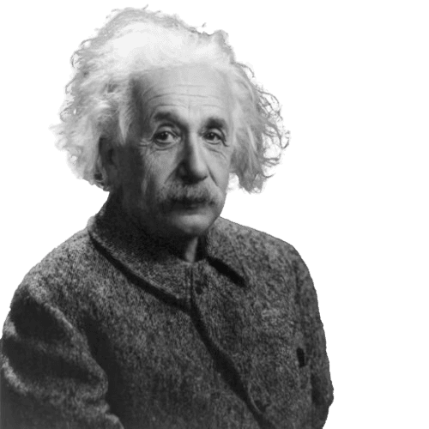
“We cannot solve our problem with the same thinking we used when we created them.” Albert Einstein
Today’s challenges demand not just better management, but Transformative Mindset in Project Management

Slide 4
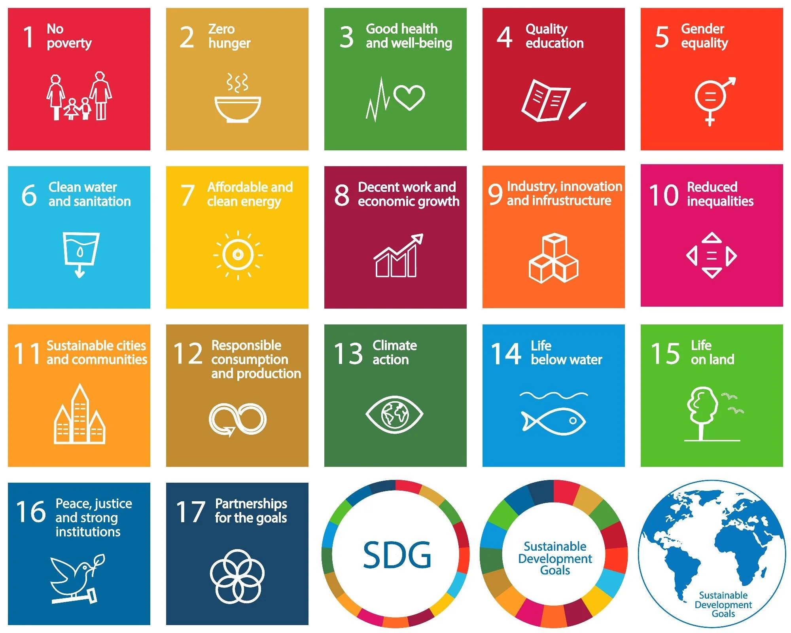
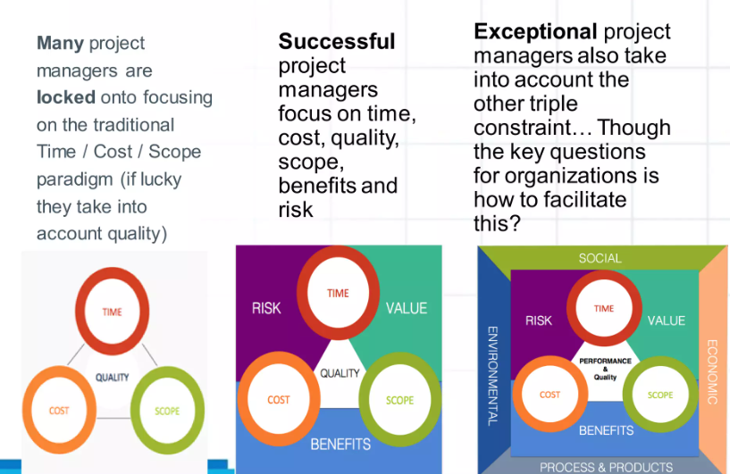
Strategic Project Decisions for a Sustainable Future
Real Projects, Real People and Real Impact
A transformative mindset puts human outcomes at the center.
Adopt a mindset where success is not just measured in milestones, but in meaningful progress.
Projects is not just about delivering on Time, Cost and Scope; but making a real-impact for real people
Shift
Source: 2030 UN Agenda for Sustainable Development.pdf
Notes:
Imagine a young girl in a rural area, Kintampo” or “What if your next project could improve someone’s life for the next 50 years?”

Slide 5
6 Principles of Sustainable Project Management
Sustainable project management isn't just about doing projects right; it’s about doing the right projects, for the right reasons, with lasting impact.
  Integration of sustainability into Project objectives
  Stakeholder Inclusiveness and Engagement
  Resource Efficiency and Waste Reduction
Align project goals with the triple bottom line: people, environment and profit
Embed SDG relevant target into project planning and execution
Involve all relevant stakeholders, including communities, regulators, and underrepresented groups.
Prioritize transparent dialogue and collaborative decision-making.
Optimize use of energy, materials, and manpower.
Integrate lean project methods and green procurement strategies.
  Risk Management with Sustainability Lens
  Transparent and Ethical Governance
  Life Cycle Thinking
Identify environmental, social, and governance (ESG) risks early.
Incorporate sustainability metrics into risk assessment tools.
Uphold integrity in procurement, contracting, and stakeholder relations.
Monitor impact reporting and ensure accountability across the life cycle.
Consider the full life span of the project: design, implementation, operation, and decommissioning.
Plan for adaptability, circularity, and long-term benefits.
Notes:
These principles empower project leaders to make informed, ethical, and forward-thinking decisions turning each project into a driver of positive change.

Slide 6
What Next?
The Paradigm Shift
Project Management and Technology (AI)
Add mark here

Slide 7
Transformational Mindset Pillars
Impact on transformative mindset on sustainability Practices
A
C
E
Stakeholders
&
People Center
AI
Technology Adoption
Continuous Innovation
B
D
Cross-Functional Alignment
Data & Business Intelligence

Slide 8
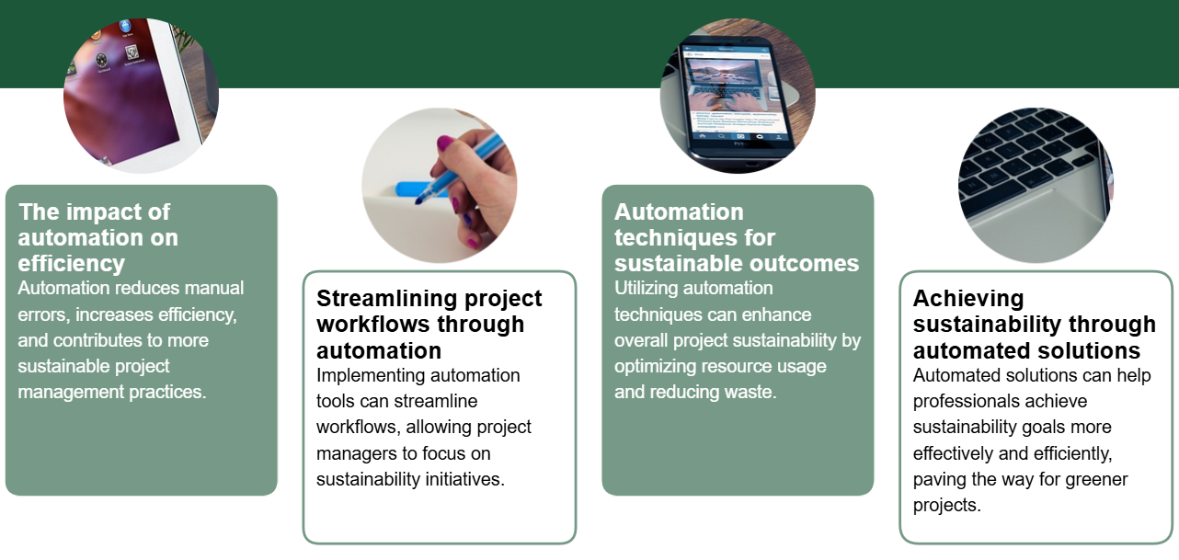
Automating Processes to enhance Project Sustainability
Sustainable Project Management (SPM) integrates environmental, social, and economic considerations into all phases of a project to ensure long-term viability and positive impacts

Slide 9
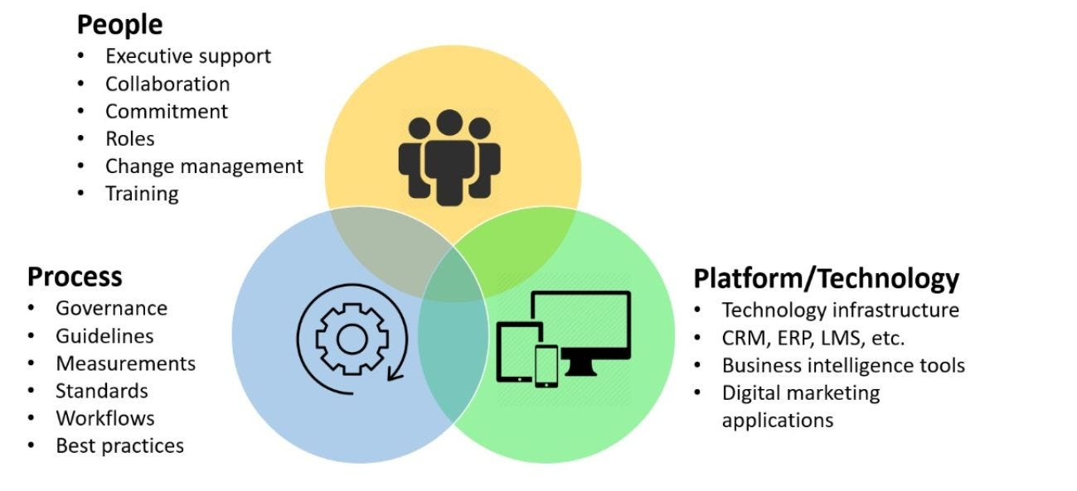
Technology as a Game Changer in Projects
Optional subtitle, sentence case 20pt
Technology is revolutionizing project management by enhancing decision-making processes and operational efficiency.
AI tools provide predictive analytics, enabling project managers to foresee potential challenges and allocate resources more effectively.
This technological integration not only streamlines processes but also supports strategic alignment with sustainability objectives, ensuring projects are future-ready.
Data
AI, Machine Learning and Automation

Slide 10
6 Aspect of Project Management that will be Disruption
Data and People Make the Future a Reality
1
Step 01
2
Step 02
3
Step 03
Best Selection and Prioritization
Support for the PMO
Improved project definition and planning
Removal of human biases from decision making
A better balance in the project portfolio and overview of risk in the organization
Better monitoring of project progress
Automated preparation and distribution of project reports, and gathering of feedback
New applications use big data and ML to help leaders and project managers anticipate risks that might otherwise go unnoticed.
4
Step 04
5
Step 05
6
Step 06
Virtual Project Assistants
Advance Testing system and Software
New Role for Project Manager
The digital assistant learns from past time entries, project planning data, and the overall context to tailor interactions and smartly capture critical project information.
Advanced and automated system testing solutions for software projects will soon allow early detection of defects and self correcting processes. This will significantly reduce time spent on cumbersome testing activities, reduce the number of reworks, and ultimately, deliver easy-to-use and bug-free solutions.
With a shift away from administrative work, the project manager of the future will need to cultivate strong soft skills, leadership capabilities, strategic thinking, and business acumen.

Slide 11

Process – 6 items
Be encouraged to take the first steps toward this positive vision of future of sustainable project management now.
Sustainable project management isn't just about doing projects right, it’s about doing the right projects, for the right reasons, with lasting impact.
Reimagining Project Management for Sustainable Success

